Slide 1

The Disrupting Samaritans 1
AI Hackathon.

Slide 2



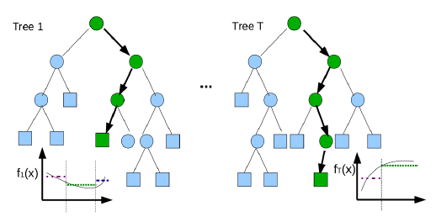
Technology Stack.
PYTHON 3.6
Libraries Used:
Python Pandas
NumPy
Scikit learn – LabelEncoder, StandardScaler and RandomForestClassifier
Regular Expression (re)
MicroStrategy for Data Exploration

Slide 3

Problem being solved
Group materialisation Forecast:
Groups book in bulk and block a large number of seats on a flight departure date. The general behaviour of group bookings is volatile. A group materialisation model will predict the expected materialisation rate on the reservations and will help influence the overbooking levels to avoid empty seats due to last minute cancellations.

Slide 4
Approach
Data Analysis
Features selection
Feature pre-processing
Correlation w.r.t target
Correlation with other features
Machine Learning model Training and Evaluation

Slide 5
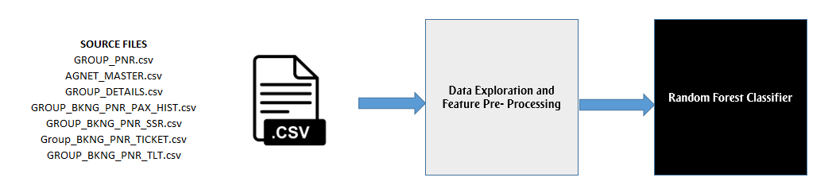
High Level Solution Architecture

Slide 6
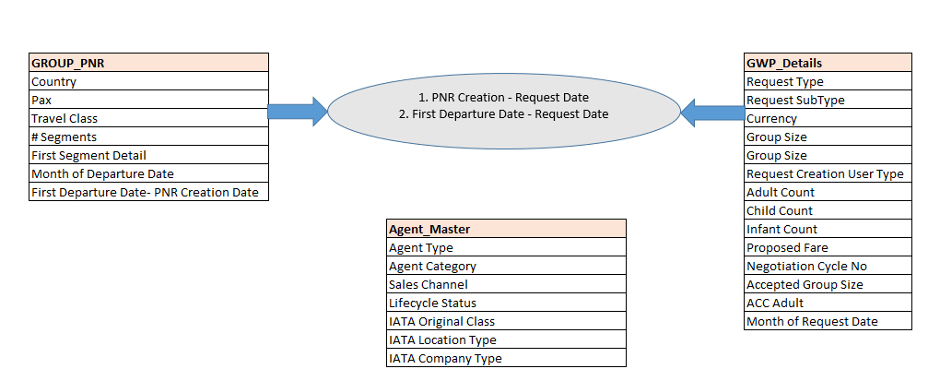
Feature Selection – Initial Phase

Slide 7
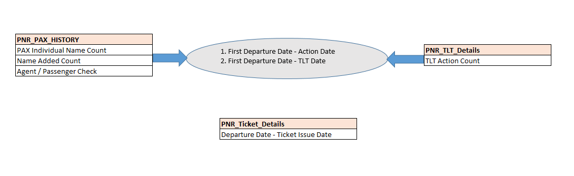
Feature Selection – Detail Phase

Slide 8
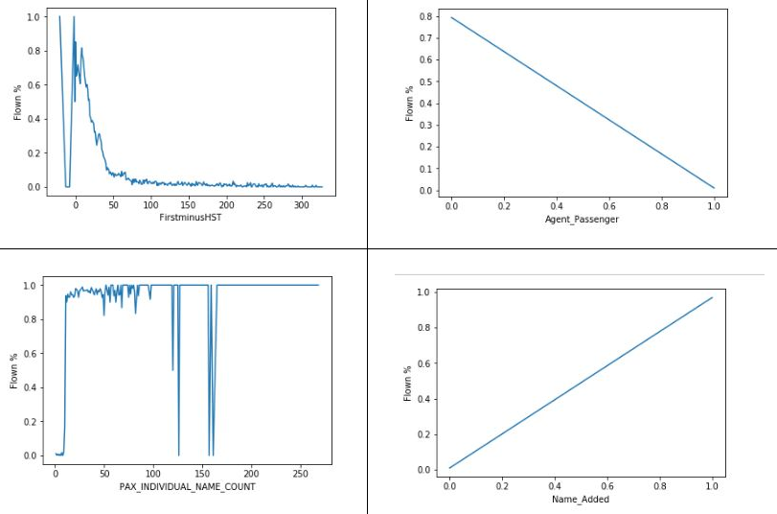
Correlation w.r.t Target (1/3)

Slide 9
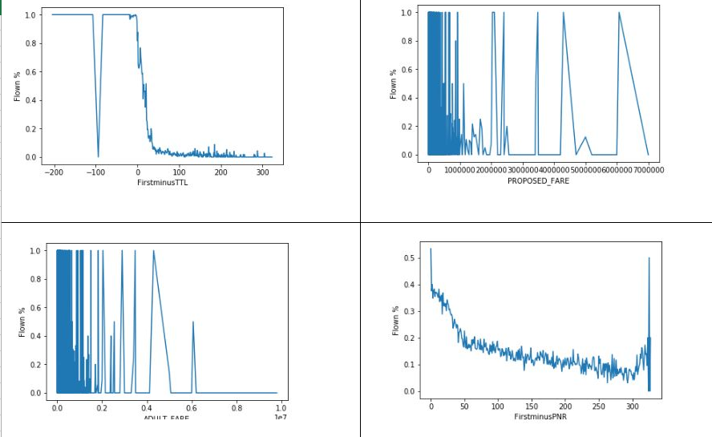
Correlation w.r.t Target (2/3)

Slide 10
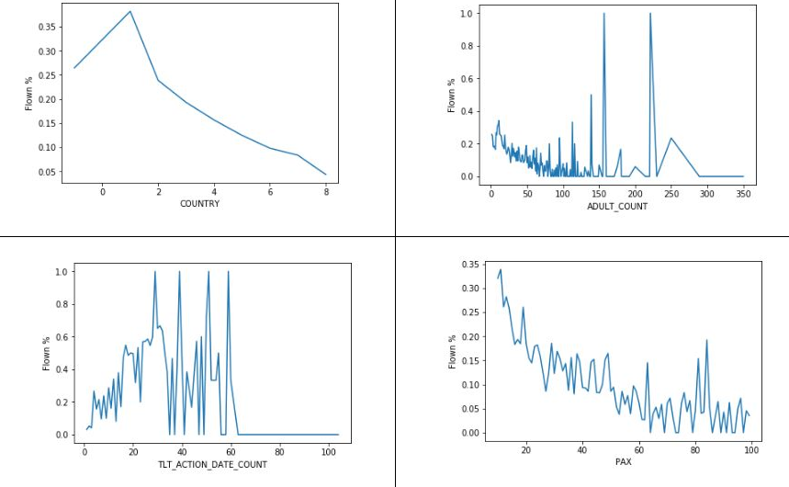
Correlation w.r.t Target (3/3)

Slide 11
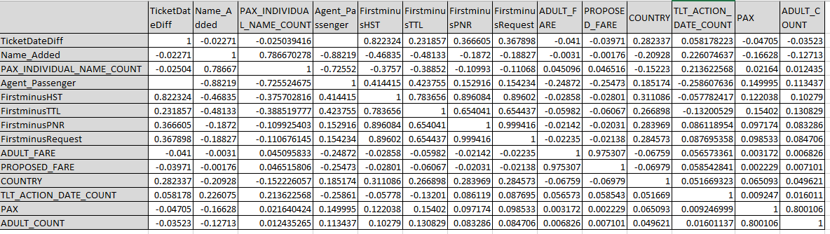
Correlation with other features

Slide 12
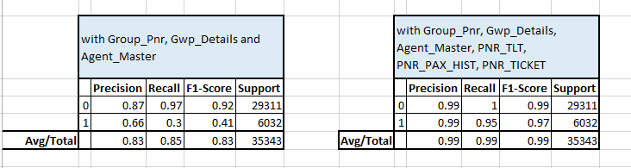
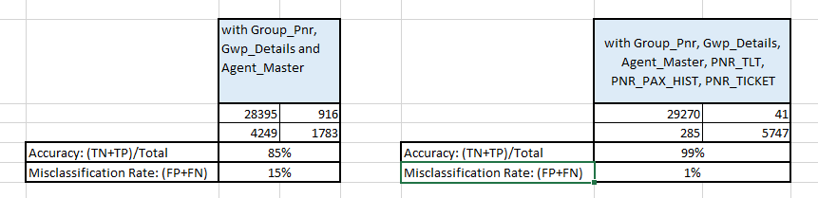
Model – Training and Evaluation Details
Random Forest Classifier: (n_estimators=200)
Classification Report:
Confusion Matrix:

Slide 13
Conclusion

Slide 14
Appendix
Feature Selection
Other machine learning models tried

Slide 15
Thank You

